Slide 1

Anatomy and Physiology Component 2
Nervous System
Notes:
Learner will need access to Ambulance Care Essentials 2nd Ed.
Ref: Ambulance Care Essentials 2nd Ed. – Chapter 13 Disability pg 217-222

Slide 2

Objectives
Nervous System - Component 2
Explain the structure & functions of the nervous system.

Slide 3
Introduction
Nervous System - Component 2
The nervous system performs three main functions in order to carry out a complex range of tasks including:
Controlling body movement
Regulating heart rate
Creating memories
Producing speech
Notes:
Ref: Ambulance Care Essentials 2nd Ed. – Chapter 13 Disability pg 217
The nervous system detects and responds to changes inside and outside the body.

Slide 4
Main Functions
Nervous System - Component 2
Sensory function (perception):
Receptors located around the body detect internal stimuli, e.g. changes in BP & external stimuli, e.g. bad odour and transmit this via afferent nerves through the cranial & spinal nerves & into the brain & spinal cord.
Notes:
Ref: Ambulance Care Essentials 2nd Ed. – Chapter 13 Disability pg 217

Slide 5
Main Functions
Nervous System - Component 2
2. Information transfer and processing:
Nerve cells (neurons) have special projections (axons) that allow the conduction of electrical impulses.
These can be delivered to other neurons and/or modified by or integrated with other impulses to create a complex web that can process sensory information received from afferent neurons.
Notes:
Ref: Ambulance Care Essentials 2nd Ed. – Chapter 13 Disability pg 217

Slide 6
Main Functions
Nervous System - Component 2
3. Motor function:
This is the nervous system’s response to the processing stage & is communicated via efferent nerves, which carry electrical impulses from the brain via cranial or spinal nerves. This enables the brain to control the body as well as ventilation & circulation.
Notes:
Ref: Ambulance Care Essentials 2nd Ed. – Chapter 13 Disability pg 217

Slide 7
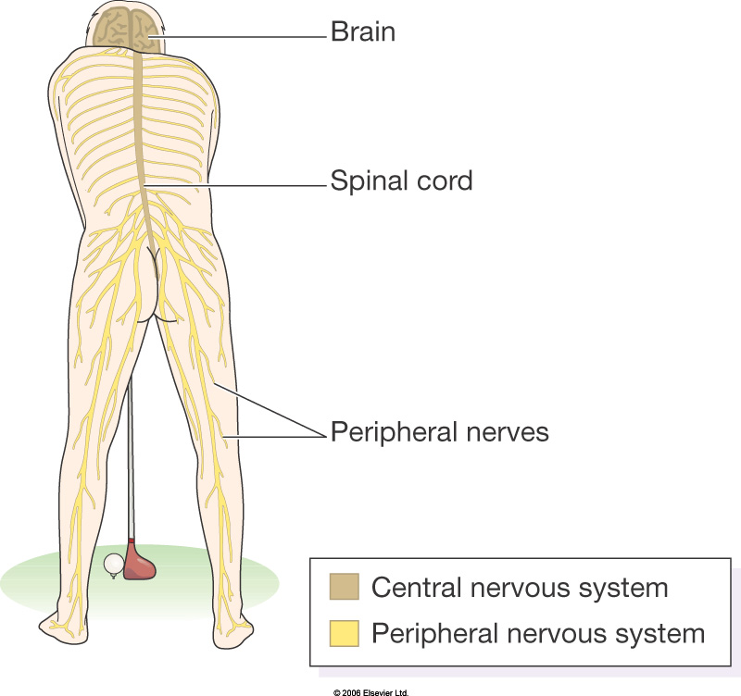
Structure
Nervous System - Component 2
The nervous system consists of the
brain & spinal cord, referred to as the
central nervous system (CNS).
A network of peripheral nerves
originating from the brain or spinal
cord, together with ganglia form the
peripheral nervous system (PNS).
Notes:
Ref: Ambulance Care Essentials 2nd Ed. – Chapter 13 Disability pg 217
PNS – Nerves that originate from the brain do so as 12 pairs of cranial nerves or as 31 pairs of spinal nerves from the spinal cord.
Ref: Ross and Wilson 12th Ed. – Chapter 7 – The nervous system pg 170-172
Originate from nuclei in the base of the brain
Distribute signals to & from structures mostly within the head and neck
12 pairs of nerves; Involved in – senses of smell, sight, taste and hearing, moving our eyes, lenses & pupils and in producing tears. Chewing, swallowing and gag reflex (+ toothache). Facial expressions and shrugging the shoulders.
Vagus Nerve (The Wanderer)
Olfactory – sense of smell
Optic – sense of sight
Occulomotor – move the eyeball, lens & pupil
Trochlear – move the eyeball
Trigeminal – chewing and facial movements
Abducens – move the eyeball
Facial – taste & facial expression
Vestibulocochlear – hearing + posture & balance
Glossopharyngeal – move the tongue, swallowing, gag reflex
Vagus – most extensive distribution (hence the wanderer). Pass from the cranium into the neck and thorax and abdomen. Important part of the autonomic nervous system. Pass messages to and from –
pharynx, larynx, trachea, bronchi, heart, carotid bodies, oesophagus, stomach, intestines, pancreas, gall bladder, bile ducts, spleen, kidneys, ureter and blood vessels!!!!
11) Accessory – attach to the sternocleidomastoid and trapezius muscles
12) Hypoglossal – swallowing & speech

Slide 8

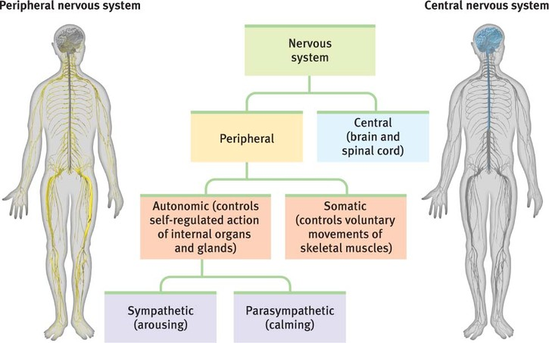
Peripheral Nervous System (PNS)
Nervous System - Component 2
Nervous System

Slide 9
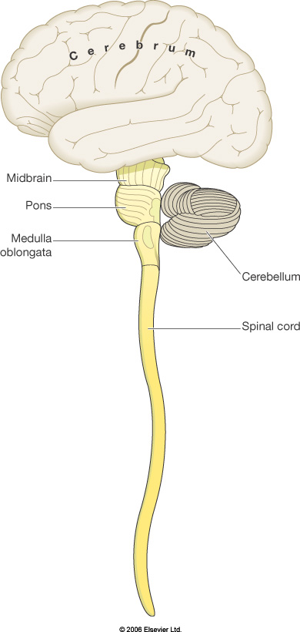
Central Nervous System (CNS)
Nervous System - Component 2
Brain
Spinal Cord
Receives sensory information from
nerves, analyses and processes the information
and responds by sending impulses via nerves to
the body to have an effect
Notes:
Ref: Ambulance Care Essentials 2nd Ed. – Chapter 13 Disability pg 219-220
Ross and Wilson 12th Ed. – Chapter 7 – The nervous system pg 152-164

Slide 10
Peripheral Nervous System
Nervous System - Component 2
The PNS consists of two divisions:
Sensory or afferent division: Composed of sensory receptors in the skin. Their nerve impulses are conveyed by somatic sensory fibres, as well as internally around the body.
Motor of efferent division: This is split into the somatic nervous system & the autonomic nervous system.
Notes:
Ref: Ambulance Care Essentials 2nd Ed. – Chapter 13 Disability pg 217-218
The PNS consists of two divisions. The first is the sensory, or afferent, division, which is composed of large numbers of receptors in the skin. Their nerve impulses are conveyed by somatic sensory fibres, as well as internally around the body (impulses from which are transmitted by visceral sensory fibres), and an extensive network of neurons around the gastrointestinal tract, collectively known as the enteric plexus, which helps regulate digestion. The other division of the PNS is the motor, or efferent, division. This is split into the somatic nervous system and the autonomic nervous system [Marieb, 2013; Tortora, 2008].

Slide 11
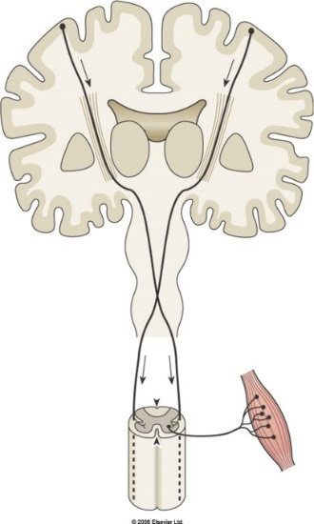
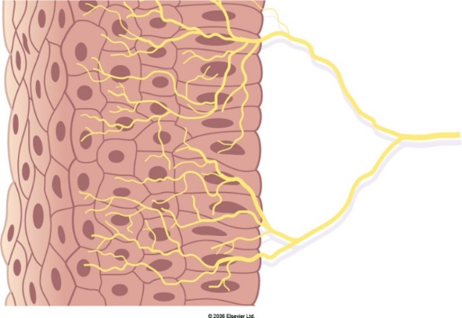
Peripheral Nervous System (PNS)
Nervous System - Component 2
Peripheral Nervous System
(all the nerves outside the brain and spinal cord)
Motor (efferent) nerves transmit impulses from the CNS to the body
Sensory (afferent) nerves transmit impulses towards the CNS from the body
Notes:
Ref: Ambulance Care Essentials 2nd Ed. – Chapter 13 Disability pg 217-218
Ross and Wilson 12th Ed. – Chapter 7 – The nervous system pg 165-173

Slide 12
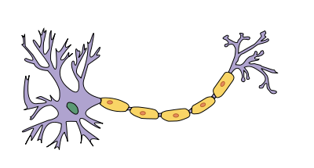
Neurons
Nervous System - Component 2
Neurons are the cells in the nervous
system that generate electrochemical
impulses enabling the nervous system to function. Most consist of:
Cell body
Dendrites
Axon
Notes:
Ref: Ambulance Care Essentials 2nd Ed. – Chapter 13 Disability pg 218

Slide 13
Neurons
Nervous System - Component 2
Each neurone has
One cell body One axon Many dendrites
Cell body: Where the nucleus & other cellular
organelles are found.
Dendrites: The receiving or input portions of a neuron that carry impulses towards the cell body.
Axon: Long, thin portion of the neuron which transmits electrical signals from the cell body to the axon terminals. Neurons communicate with each other via chemicals called synaptic bulb ends.
Neurons vary in size & shape & speed of conduction. Neurons with axons covered with myelin sheaths can conduct electrical impulses much faster than those that do not.
Notes:
Ref: Ambulance Care Essentials 2nd Ed. – Nervous system anatomy & physiology, pg 218

Slide 14
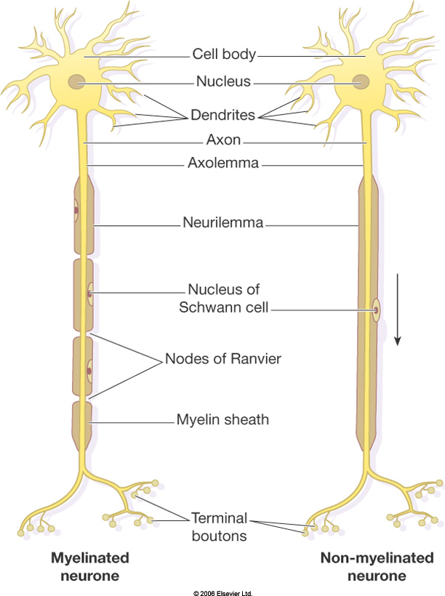
Myelin sheath formed by concentric Schwann cells
Nodes of Ranvier assist in the rapid transmission of nerve impulses
Myelin sheath – protects nerve cells
Schwann cells – multiple functions
within peripheral nervous system
Notes:
Ref: Ambulance Care Essentials 2nd Ed. – Chapter 13 Disability pg 218
Ross and Wilson 12th Ed. – Chapter 7 – The nervous system pg 146

Slide 15
Neuroglia
Nervous System - Component 2
The supporting, non-impulse generating/conducting cells in the nervous system.
Roles include:
Providing structural support for neurons
Creating a blood-brain barrier
Restricting movement of substances between
the blood & tissue fluids within the CNS.
There are neuroglia that take on the role of
phagocyte, removing debris & damaged tissue.
Notes:
Ref: Ambulance Care Essentials 2nd Ed. – Chapter 13 Disability pg 218

Slide 16
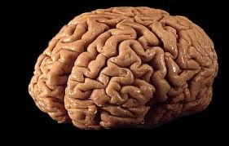
Brain
Nervous System - Component 2
The portion of the CNS contained
within the skull is known as the brain.
The brain occupies 80% of the cranial
Vault
Remaining 20% made up of cerebral
blood (12%) and cerebral spinal fluid (8%).
It has a wide range of functions as well as serving as the centre for intellect, emotions, behaviour & memory.
Notes:
Ref: Ambulance Care Essentials 2nd Ed. – Chapter 13 Disability pg 219-220
Ross and Wilson 12th Ed. – Chapter 7 – The nervous system pg 154-160
Uses 20% of the body’s oxygen & 25% of its glucose
Has no stores of either so requires a continuous supply
Any interruption in this supply will quickly cause cell injury (within minutes)

Slide 17
Brain
Nervous System - Component 2
The brain is divided into four major sections:
Brain Stem
Cerebellum
Diencephalon
Cerebrum
Notes:
Ref: Ambulance Care Essentials 2nd Ed. – Chapter 13 Disability pg 219-220

Slide 18
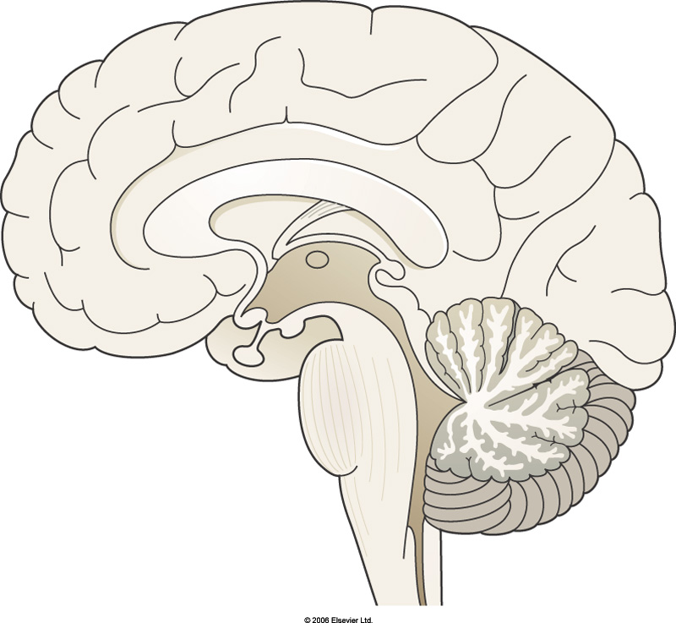
Brain Stem
Nervous System - Component 2
Consists of the:
  Mid Brain
  Pons Varolli
  Medulla Oblongata
Notes:
Ref: Ambulance Care Essentials 2nd Ed. – Chapter 13 Disability pg 219
Ross and Wilson 12th Ed. – Chapter 7 – The nervous system pg 159-160

Slide 19
Medulla Oblongata
Nervous System - Component 2
Relays sensory & motor input between other parts of the brain & spinal cord.
Together with pons & midbrain, controls level of consciousness.
Contains centres to manage heart rate, BP & breathing.
Contains origins of a number of cranial nerves.
Notes:
Ref: Ambulance Care Essentials 2nd Ed. – Chapter 13 Disability pg 219
Ross and Wilson 12th Ed. – Chapter 7 – The nervous system pg 159-160
Motor nerves descending from the motor area of the cerebrum cross over from one side to the other in the medulla before they get to the spinal cord.
This means that the left hemisphere of the cerebrum controls the motor actions of the right half of the body and the right hemisphere of the cerebrum controls the motor actions of the left half of the body

Slide 20
Pons Varolli
Nervous System - Component 2
Relays nervous impulses from one side of the cerebellum to the other & between medulla & midbrain.
Contains origins of a number of cranial nerves.
Contains centres to regulate breathing.
Notes:
Ref: Ambulance Care Essentials 2nd Ed. – Chapter 13 Disability pg 219

Slide 21
Midbrain
Nervous System - Component 2
Relays motor output from the cerebral cortex & sensory input from the spinal cord to the thalamus.
Controls & co-ordinates movement.
Contains origins of two cranial nerves.
Notes:
Ref: Ambulance Care Essentials 2nd Ed. – Chapter 13 Disability pg 219

Slide 22

Cerebellum
Nervous System - Component 2
Has two hemispheres
Responsible for coordinating complex & skilled movements.
Regulates posture & balance.
Notes:
Ref: Ambulance Care Essentials 2nd Ed. – Chapter 13 Disability pg 220
Ross and Wilson 12th Ed. – Chapter 7 – The nervous system pg 160
Contains about 70 billion neurones
Picture - http://www.livescience.com/48122-cerebellum-makes-humans-special.html

Slide 23
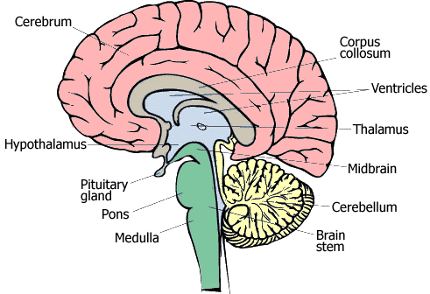
Diencephalon
Nervous System - Component 2
Located deep within the brain, underneath the cerebrum
Connects the cerebrum with
the brain stem
Is the link between the nervous
system & the endocrine system
Comprised of the thalamus & hypothalamus
Notes:
Ref: Ambulance Care Essentials 2nd Ed. – Chapter 13 Disability pg 220
Ross and Wilson 12th Ed. – Chapter 7 – The nervous system pg 159

Slide 24
Diencephalon
Nervous System - Component 2
Thalamus:
Relays sensory input to the cerebral cortex
Provides perception of touch, pressure, pain & temperature
Hypothalamus:
Controls & integrates autonomic
nervous system activity
Regulates behavioural patterns &
circadian rhythms
Controls body temperature
Regulates eating & drinking
Notes:
Ref: Ambulance Care Essentials 2nd Ed. – Chapter 13 Disability pg 220

Slide 25
Cerebrum
Nervous System - Component 2
The cerebrum allows you to read, write & speak.
Various regions are responsible for a range of other functions:
Sensory areas are involved in perception of sensory information.
Motor areas control muscular movements.
Association areas are responsible for complex functions such as memory, personality & intelligence.
Notes:
Ref: Ambulance Care Essentials 2nd Ed. – Chapter 13 Disability pg 220

Slide 26
Cerebrum
Nervous System - Component 2
The largest part of the brain
Split into two hemispheres (left and right)
Has an outer rim of grey matter & an internal region of white matter
The outer rim of grey matter contains the cerebral cortex, which, although thin contains billions of neurons
Notes:
Ref: Ambulance Care Essentials 2nd Ed. – Chapter 13 Disability pg 220

Slide 27
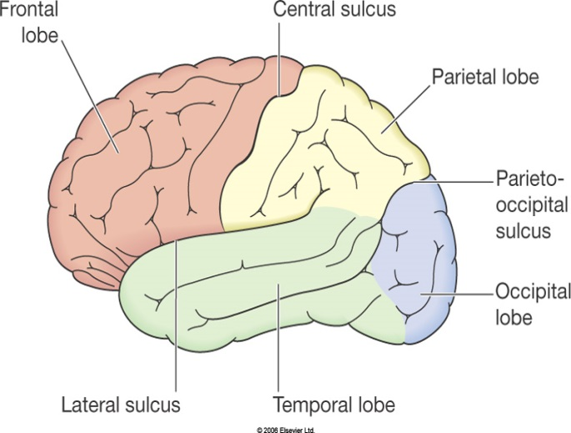
Cerebrum
Nervous System - Component 2
Each hemisphere can also be further divided into four lobes
FRONTAL
PARIETAL
TEMPORAL
OCCIPITAL
Notes:
Ref: Ambulance Care Essentials 2nd Ed. – Chapter 13 Disability pg 220
Ross and Wilson 12th Ed. – Chapter 7 – The nervous system pg 154-159
Each lobe can be ‘mapped’ as having specific roles in specific functions, e.g:
Frontal – motor area, motor speech area, intellect, judgement, behaviour, prediction
Parietal – awareness of movement and position
Temporal – sound and interpretation, smells
Occipital – visual perception and association
Sulci - mark the boundaries of the lobes

Slide 28
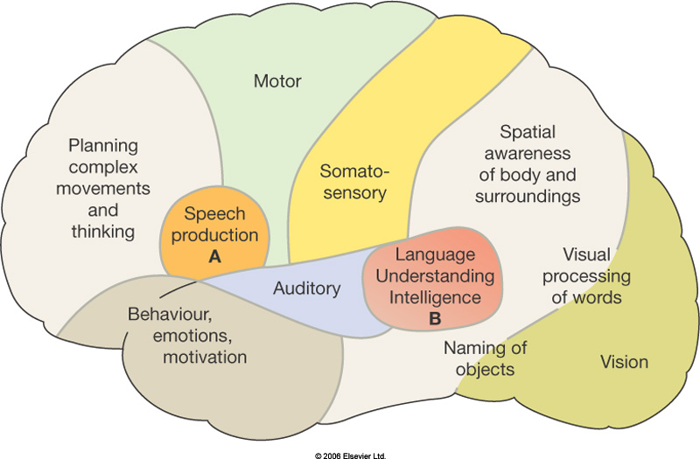
Heading Calibri (Headings) Font 40
Nervous System - Component 2
Notes:
Ref: Ross and Wilson 12th Ed. – Chapter 7 – The nervous system pg 154-159
Each lobe can be ‘mapped’ as having specific roles in specific functions, e.g:
Frontal – motor area, motor speech area, intellect, judgement, behaviour, prediction
Parietal – awareness of movement and position
Temporal – sound and interpretation, smells
Occipital – visual perception and association

Slide 29
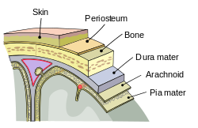
Meninges
Nervous System - Component 2
In addition to the skull, the brain is protected by the meninges. There are three of them:
Dura Mater
Arachnoid Mater
Pia Mater
Notes:
Ref: Ambulance Care Essentials 2nd Ed. – Chapter 13 Disability pg 220

Slide 30
Meninges
Nervous System - Component 2
Dura Mater: Tough outer layer consisting of connective tissue.
Arachnoid Mater: Middle layer. The sub-arachnoid space (between arachnoid & pia layers) is filled with cerebrospinal fluid (CSF).
Pia Mater: Delicate inner layer containing small blood vessels that supply O2 & nutrients to the brain.
Notes:
Ref: Ambulance Care Essentials 2nd Ed. – Chapter 13 Disability pg 220

Slide 31
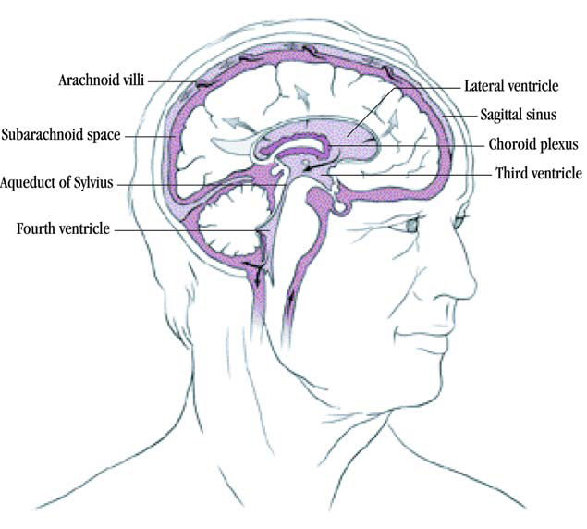
Cerebrospinal Fluid (CSF)
Nervous System - Component 2
CSF is a clear, colourless liquid
Protects the brain & spinal cord from physical & chemical injury.
Carries O2, glucose & other
nutrients essential for normal
brain function.
Removes waste products.
Notes:
Ref: Ambulance Care Essentials 2nd Ed. – Chapter 13 Disability pg 220
Ross and Wilson 12th Ed. – Chapter 7 – The nervous system pg 153-154
The CNS contains an interconnecting series of chambers
There are 4 chambers (ventricles) in the brain and a central canal in the spinal cord
CSF is secreted constantly into each ventricle of the brain by specialised cells (choroid plexuses) at a continuous rate of 0.5mL per minute
CSF flows from the ventricles into the subarachnoid space and flows around it surrounding the brain and the spinal cord, it’s movement aided by pulsating blood vessels, posture and respiration
The volume remains constant, absorption keeping up with secretion, unless compensation needs to be made for pathological reason
CSF is absorbed by projections from the arachnoid mater (arachnoid villi)

Slide 32
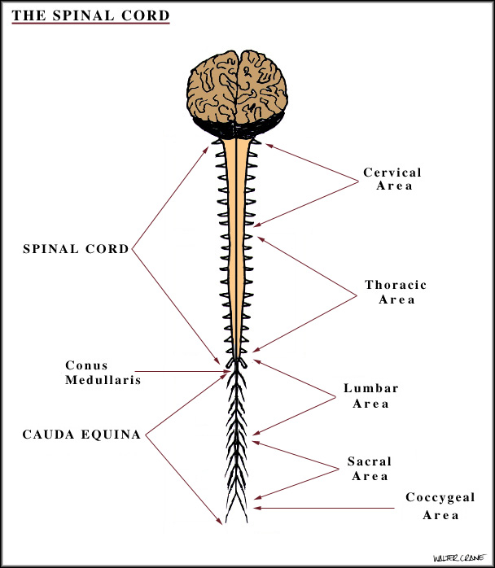
Spinal Cord
Nervous System - Component 2
The vertebral column consists of 33
vertebrae:
7 cervical
12 thoracic
5 lumbar
5 sacral
4 coccygeal
Part of their function is to provide
physical protection for the spinal
cord, which the vertebrae encapsulate.
Notes:
Ref: Ambulance Care Essentials 2nd Ed. – Chapter 13 Disability pg 220
Additional protection is provided by vertebral ligaments, meninges & the cerebral spinal fluid (CSF).

Slide 33
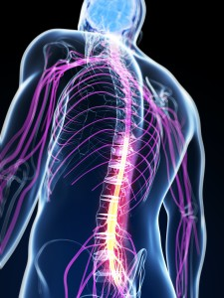
Spinal Cord
Nervous System - Component 2
Cylindrical in shape
Average diameter is 12mm
Extends from the medulla oblongata to the
superior border of 2nd lumbar vertebrae
Tapers to form a cone-like structure called the conus medullaris
Nerves that originate distal to the conus medullaris form the cauda equine (meaning horses-tail)
Contain afferent fibres, which transmit sensation and efferent motor fibres
Notes:
Ref: Ambulance Care Essentials 2nd Ed. – Chapter 13 Disability pg 219
The spinal cord is almost cylindrical in shape, although slightly squashed in the anterior-posterior dimension. It’s average diameter is just 12mm, and in adults it extends from the medulla oblongata to the superior border of the second lumbar vertebrae (L2), i.e. it does not extend the full length of the vertebral column. Instead, it tapers to form a cone-like structure called the conus medullaris. Nerves that originate distal to the conus medullaris form the cauda equine (meaning horses-tail). These nerves have a dorsal root containing afferent fibres, which transmit sensation, and a ventral root containing efferent motor fibres.

Slide 34
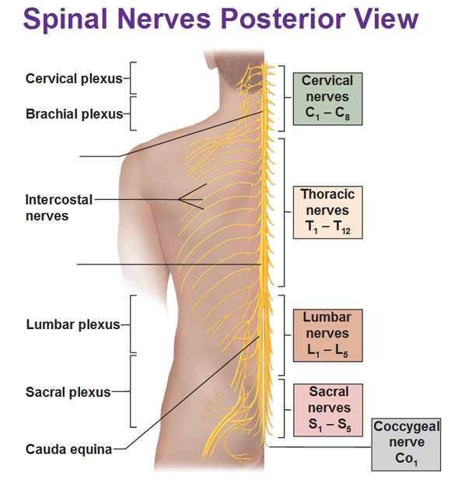
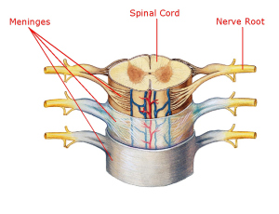
Spinal Nerves
Nervous System - Component 2
There are 31 pairs of spinal nerves:
8 cervical
12 thoracic
5 lumbar
5 sacral
1 coccygeal
Notes:
Ref: Ambulance Care Essentials 2nd Ed. – Chapter 13 Disability pg 220
Ross and Wilson 12th Ed. – Chapter 7 – The nervous system pg 165-170
The first pair leave the vertebral canal between the occipital bone and the first cervical vertebra
8 cervical
12 thoracic
5 lumbar
5 sacral
1 coccygeal
At the cords end at L1 the lumbar, sacral & coccygeal spinal nerves begin to divide and fan out (forming the Cauda Equina) but stay within the vertebral canal until in their pairs they then leave the vertebral canal between the vertebra.

Slide 35
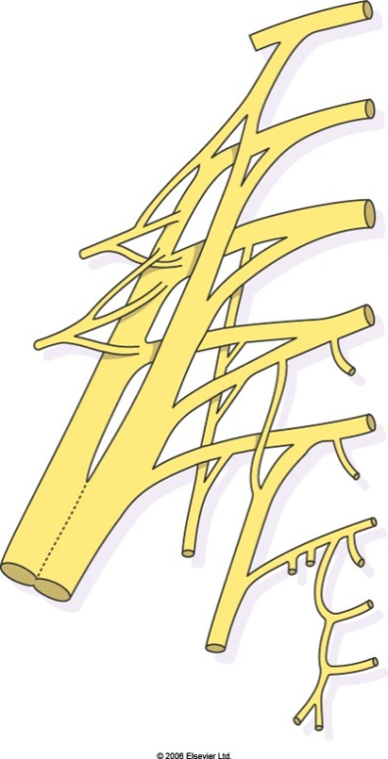
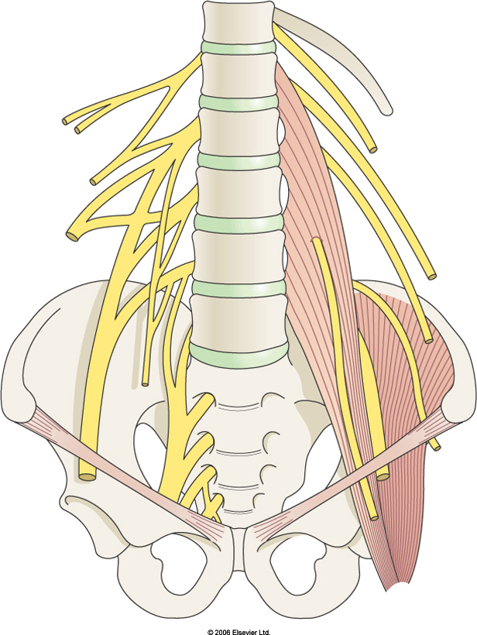
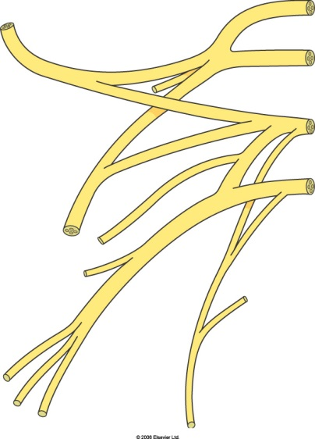
Spinal Nerves
Nervous System - Component 2
Notes:
Ref: Ross and Wilson 12th Ed. – Chapter 7 – The nervous system pg 165-170
Immediately after emerging form the vertebral canal, spinal nerves divide into branches (rami)
In the cervical, lumbar & sacral regions the rami unite near their origins to form bundles of nerves (plexuses) where nerves are rearranged before proceeding to their destination. This means that structures have nerve supply from more than one spinal nerve so damage to a particular spinal nerve might not necessarily mean complete loss of function. The plexuses lie deep within the body and are therefore well protected from injury

Slide 36
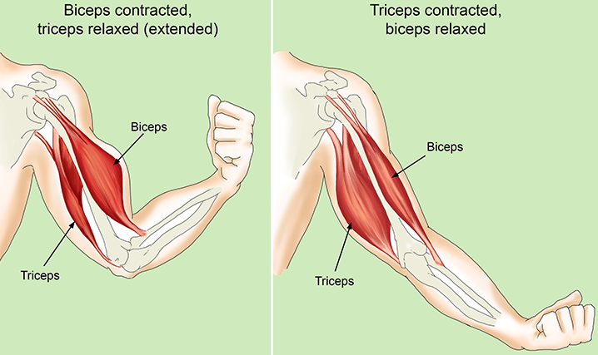
Somatic Nervous System
Nervous System - Component 2
Also known as the voluntary nervous system.
Allows a person to consciously control their skeletal muscles due to somatic nerve fibres that conduct impulses from the central nervous system to the skeletal muscles.
Notes:
Ref: Ambulance Care Essentials 2nd Ed. – Chapter 13 Disability pg 220-221

Slide 37
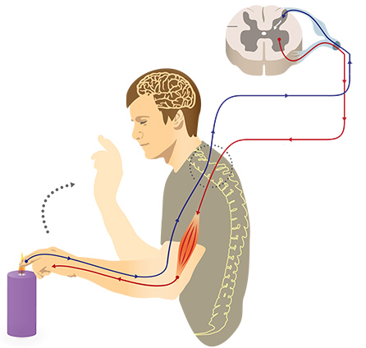
Somatic Nervous System
Nervous System - Component 2
Includes an involuntary
component, reflexes.
Primarily a protective mechanism.
Notes:
Ref: Ambulance Care Essentials 2nd Ed. – Chapter 13 Disability pg 220-221
However, the somatic nervous system also includes an involuntary component: reflexes. These are primarily a protective mechanism, for instance removing your hand when you touch something hot.

Slide 38
Autonomic Nervous System (ANS)
Nervous System - Component 2
The ANS is divided into three parts:
Sympathetic nervous system
Parasympathetic nervous system
Enteric nervous system
The hypothalamus & brainstem regulate ANS activity.
Notes:
Ref: Ambulance Care Essentials 2nd Ed. – Chapter 13 Disability pg 221-222
Ross and Wilson 12th Ed. – Chapter 7 – The nervous system pg 173-177
They are called autonomic because it was originally believed that it functioned completely independently from the central nervous system (CNS).
Subconsciously controls body functions and homeostasis by using specific ANS nerves to affect – smooth muscle, cardiac muscle and glands
SYMPATHETIC & PARASYMPATHETIC: These two divisions work to maintain activities such as breathing, blood pressure, water balance, digestion and metabolism.
The majority of organs are supplied by both sympathetic and parasympathetic nerves which have opposing effects.

Slide 39
Enteric Division
Nervous System - Component 2
Extensive network of neurons within the walls of the gastrointestinal (GI) tract, pancreas & gall bladder.
Sensory nervous function enables monitoring of the mechanical state of the alimentary canal & the chemical status of the stomach & intestines.
Outputs motor signals to modify the motility & secretions of the gut.
Controls the diameter of local blood vessels.
Notes:
Ref: Ambulance Care Essentials 2nd Ed. – Nervous system anatomy & physiology pg 221

Slide 40

Sympathetic Division
Nervous System - Component 2
Prepares the body to respond to stress, facilitate sudden strenuous exercise & increased vigilance.
‘fight or flight’
Stimulates cardiac activity
Opens the airways
Dilates skeletal blood vessels
Reduces gastric activity
Notes:
Ref: Ambulance Care Essentials 2nd Ed. – Nervous system anatomy & physiology pg 221-222
Ross and Wilson 12th Ed. – Chapter 7 – The nervous system pg 174
The sympathetic division is often referred to as the fight-or-flight division as its actions prepare the body to respond to stress, facilitate sudden strenuous exercise & increased vigilance. In addition, it helps control blood pressure, thermoregulation, and gut and urogenital function.
Stimulates cardiac activity
Opens the airways
Dilates skeletal blood vessels
Reduces gastric activity

Slide 41
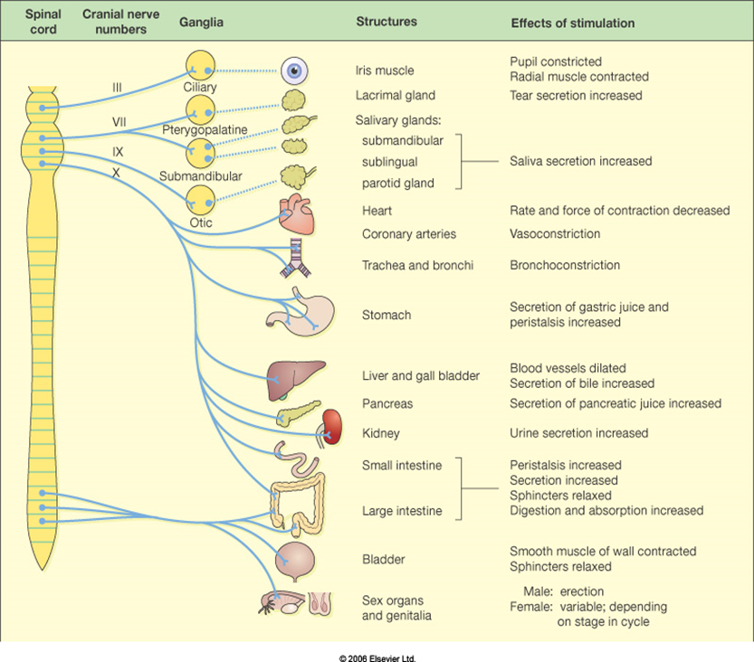
Parasympathetic Division
Nervous System - Component 2
‘Rest-&-digest division’
Has a general
‘peacemaker’ effect
Stimulates digestion &
Absorption of food
Slows down cardiac &
respiratory activities
Notes:
Ref: Ambulance Care Essentials 2nd Ed. – Nervous system anatomy & physiology pg 221-222
Ross and Wilson 12th Ed. – Chapter 7 – The nervous system pg 174
The parasympathetic division is often referred to as the rest-and –digest division. Actions of the parasympathetic division include antagonising some effects of the sympathetic divison, for example heart rate, gut motility & bronchiole diameter, & controlling many functions in non-stress states such as GI secretion to aid digestion, micturition & defecation.
Another important difference between the sympathetic & parasympathetic divisions is their structure. Parasympathetic neurons are clustered at either end of the spinal cord, whereas the sympathetic neurons originate from the thoracolumbar section.
Stimulates cardiac activity
Opens the airways
Dilates skeletal blood vessels
Reduces gastric activity

Slide 42
Revision
Nervous System - Component 2
What are the main functions of the nervous system?
Each neuron consists of 3 parts. What are they?
What are the three parts of the brain stem?
How many hemispheres does the cerebrum have?
List the three layers of the meninges.
CSF stands for?
How many vertebrae does the vertebral column consists of?
How many pairs of spinal nerves are there?
What is the name given to the part of the spinal cord that resembles a horses-tail?

Slide 43
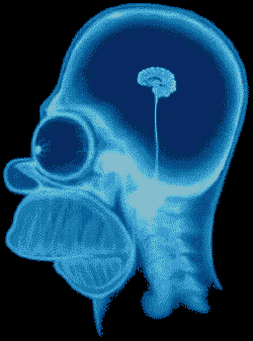
Any Questions?
Nervous System - Component 2

